Slide 1
Power of Persuasion
Goal: a style of writing with the goal of persuading the reader through written arguments.

Slide 2
How to get what you want!

Slide 3
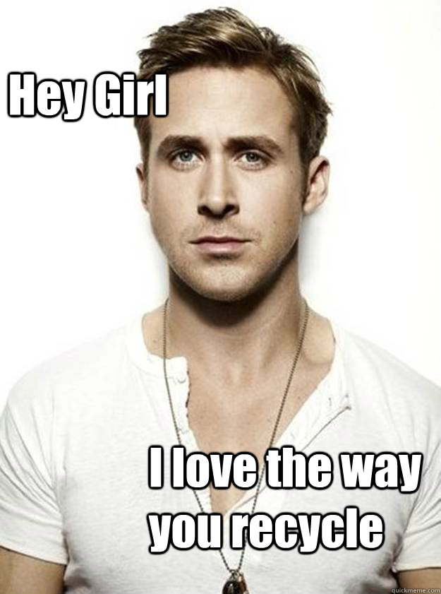
Claim – your main point
Example: Curbside pick up in Lethbridge would make recycling easier and more accessible for citizens.

Slide 4
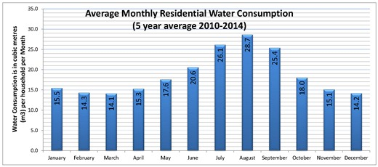
Logos – using logic, numbers, facts, and data to support your argument
Example: Water use in Lethbridge is highest during the summer months.

Slide 5
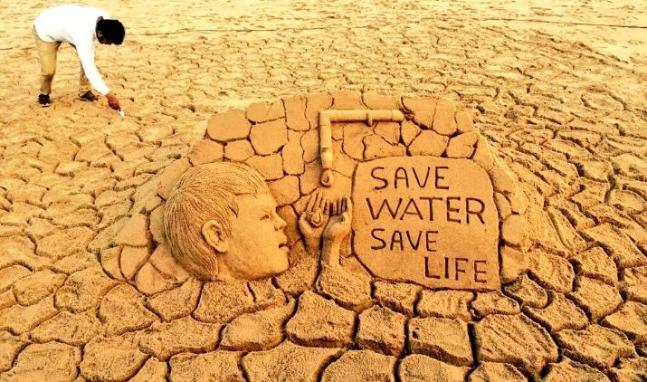
Pathos – appealing to your audience’s emotions
Example:

Slide 6
Ethos – making yourself seem trustworthy and believable
Example: who doesn’t trust Bill Nye? (he’s the science guy)

Slide 7
Kairos – building a sense of urgency for your cause
Example:

Slide 8
Research – using studies and information to make your argument seem more convincing; you can use words, graphs, tables and illustrations
Example: ensure you’re choosing reliable sources.

Slide 9
Using Logic to Argue
Begin with your claim and then explain how this leads to your logical conclusion.
Examples:
Premise 1: all men are mortal
Premise 2: Socrates is a man
Conclusion: Therefore, Socrates is mortal.
In your writing, you will present your premises with the hope of guiding your reader to what you argue, is the logical conclusion.

Slide 10
Logical Fallacies – ERRORS in Reasoning
Consider this clip ☺

Slide 11
Common Logical Fallacies you’ll hear…
Slippery Slope: conclusion that says in event A happens, then eventually through a series of steps, through B,C,D, … X, Y, Z will happen, to. Which equates A with Z. So if we don’t want Z to occur, A must not be allowed to happen,
Eg. If we ban Hummers because they are bad for the environment, eventually the government will ban all cars, so we should not ban Hummers.
If we limit the sales of assault weapons, the government will take all the guns away.

Slide 12
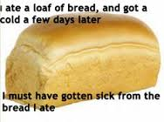
Post hoc ergo propter hoc
This is a conclusion that assumes that if event A occurred after B, then B must have caused A.
Example: I drank a bottle of water and now I am sick, so the water must have made me sick!

Slide 13
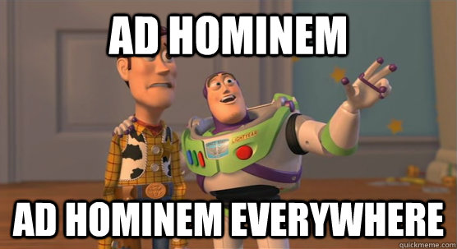
Ad hominem: an attack on the character of a person rather than his or her opinions or arguments
Example: ANY POLITICAN EVER
- often times what people LOOK like.

Slide 14
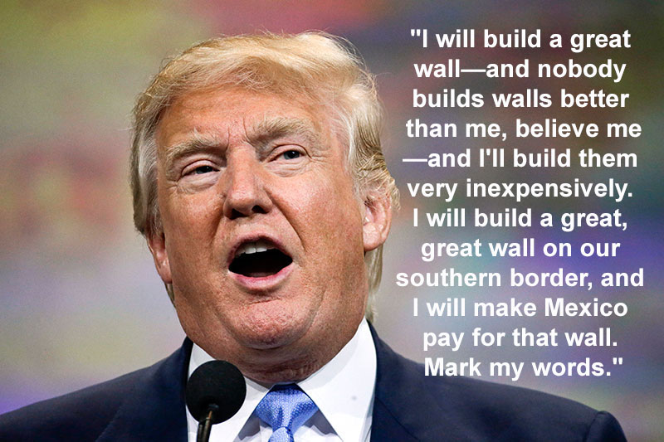
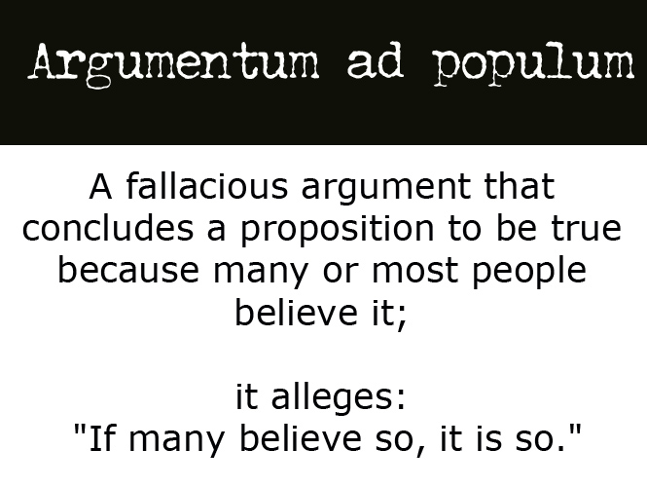
Ad populum – this is an emotional appeal that speaks to negative or positive concepts rather than the issue at hand
- saying what is popular or mainstream is what is right.
- Trump taps into the problem of illegal immigration, peoples’ frustration and fear they are losing out on jobs to those willing to work for less.
- worth noting: many experts say the wall will not work, will not be paid for by Mexico, and does not address illegals who enter by boat or plane…

Slide 15
Red Herring – diversionary tactic that avoids key issues often by avoiding opposing arguments rather than addressing them

Slide 16
Straw Man: oversimplifying an opponent’s viewpoint and then attacking that hollow argument
Example: People who don’t support the minimum wage increase hate the poor.
- you’re making the argument easier to “push over” just like it’s easier to push over a straw man versus a real person

Slide 17
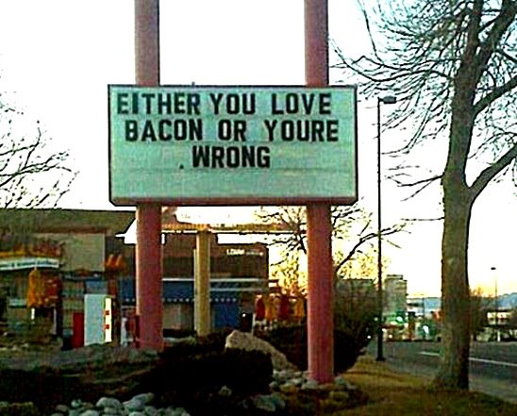
Either/or – reduces an argument to 2 sides or choices
Example: We either stop using cars or destroy the earth.

Slide 18
Watch for fallacies in your own arguments and in other peoples ☺
Make sure when you argue:
- explain your thoughts fully so that you cannot be misunderstood.
- use evidence from credible sources.
- develop your thoughts carefully and slowly.
- develop your outline first and THEN turn into complete sentences.
- make sure you have a strong topic sentence.
- consider the persuasive strategies and make use of them!
- end your paragraph with a concluding sentence.

Slide 19
How do you know a source is reliable?
- authorship – who wrote the article? What are their credentials? Does she or he have authority in this field?
- publisher – a government agency, non profit organization, commercial website? What is the reputation? Are they considered trustworthy?
- can the facts be substantiated in more than one place? By reputable sources? Has snopes debunked this? Always check multiple sources to determine accuracy/credibility
- timelines: when was the page created? When was it updated? Is it current?
- footnotes/bibliographies – are legitimate sources referenced/linked – these add to credibility because you know where they got the information
- sponsorship – is this sponsored by another organization? Is that organization reputable?

Slide 20
Topic sentence:
A basic topic sentence is the quickest and simplest way to begin your paragraph. Just copy the main idea from your outline, making sure that the sentence has a subject and verb and expresses a complete thought. Make sure, too, that the sentence begins with a capital letter and ends in a period/punctuation.
Persuasive topic sentence.
Option 1: Make your statement. Do not begin explaining anything – this will happen with your supporting details.
Option 2: Ask a question.

Slide 21
Example – topic: cleaning my room
Option 1: statement
Keeping your room clean is an important routine to learn before you become an adult.
Option 2: question
Is cleaning your room actually as important as many argue it is?

Slide 22
Example: class helps write
Topic:
Option 1: (statement)
Option 2: (question)

Slide 23
Pairs: help each other write topic sentences on the following topics
- read handout
- for half of the topics, use option 1, for the other, use option 2.
- stand and turn – read your sentences out loud.

Slide 24
Individual paragraph outline
1) Choose a topic
2) Write a topic sentence
3) List your supporting details
4) Write your concluding sentence (restates your main point) uses concluding words like:
In summary,
To conclude
Therefore,
5) Hand in to Mrs. Heidinger

Slide 25
Paragraph creation
- absolutely no talking while writing
- begin with topic sentence from yesterday --- indent your first word on the first line.
- Turn point form details into full and complete sentences.
- consider the transitional device handout to make the sentences flow together. Each supporting sentence needs a capital letter and period. It must express a complete thought (contain a subject and a verb)
- conclude with your concluding sentence from yesterday.

